Slide 1
Dontha Madhusudhana Rao
Department of Computer Science

Slide 2
User Interface Design

Slide 3
What is Internet ?

Slide 4
Internet is the biggest world-wide communication network of computers.
The Internet is a vast network that connects computers all over the world. Through the Internet, people can share information and communicate from anywhere with an Internet connection.
The Internet has millions of smaller domestic, academic, business, and government networks, which together carry many different kinds of information.

Slide 5
History of Internet ?

Slide 6
The first workable prototype of the Internet came in the late 1960s with the creation of ARPANET
Advanced Research Projects Agency Network
Allow multiple computers to communicate on a single network

Slide 7
The technology continued to grow in the 1970s after scientists Robert Kahn and Vinton Cerf developed TCP/IP
Transmission Control Protocol and Internet Protocol
A communications model that set standards for how data could be transmitted between multiple networks

Slide 8
ARPANET adopted TCP/IP on January 1, 1983, and from there researchers began to assemble the “network of networks” that became the modern Internet
The online world then took on a more recognizable form in 1990, when computer scientist Tim Berners-Lee invented the WWW
WORLD WIDE WEB

Slide 9
What is WORLD WIDE WEB ? (WWW)

Slide 10
World Wide Web (which is also known as a Web), is a collection of websites or web pages stored in web servers and connected to local computers through the internet.
WWW is an information system where documents and other web resources are identified by Uniform Resource Locators (URL)
https://amazon.com, which may be interlinked by hypertext or hyperlinks, and are accessible over the Internet.

Slide 11
What is Hypertext and Hyperlink?

Slide 12
Hypertext is a word or words that contain a link to other texts or a website.
A Hyperlink is an icon, graphic, or text that links to another file.
A hypertext document with its corresponding text and hyperlinks is written and is assigned an online address called a URL.

Slide 13
The building blocks of the Web are web pages and are connected by links called "hypertext" or “hyperlinks” and accessed by using HTTP
Hypertext Transfer Protocol

Slide 14
A web page/ website is given an online address called a Uniform Resource Locator (URL).
A particular collection of web pages that belong to a specific URL is called a website
Example: www.facebook.com, www.Netflix.com, etc.
So, the World Wide Web is like a huge electronic book whose pages are stored on multiple Web servers across the world.

Slide 15
What is a Web Server ?

Slide 16
A web server is a computer that runs websites.
The basic objective of the web server is to store, process and deliver web pages to the users.
This intercommunication is done using
Hypertext Transfer Protocol (HTTP)

Slide 17
Apart from HTTP, a web server also supports
SMTP (Simple Mail Transfer Protocol)
and
FTP (File Transfer Protocol)
for emailing, file transfer and storage.

Slide 18
How to design web pages/website ?
By using HTML
Hyper Text Markup Language

Slide 19
What is
Hyper Text Markup Language(HTML) ?

Slide 20
HTML stands for Hyper Text Markup Language.
HTML is the standard markup language for creating Web pages.
HTML describes the structure of a Web page.
HTML consists of a series of elements.
HTML elements tell the browser how to display the content.

Slide 21
HTML Page Structure

Slide 22
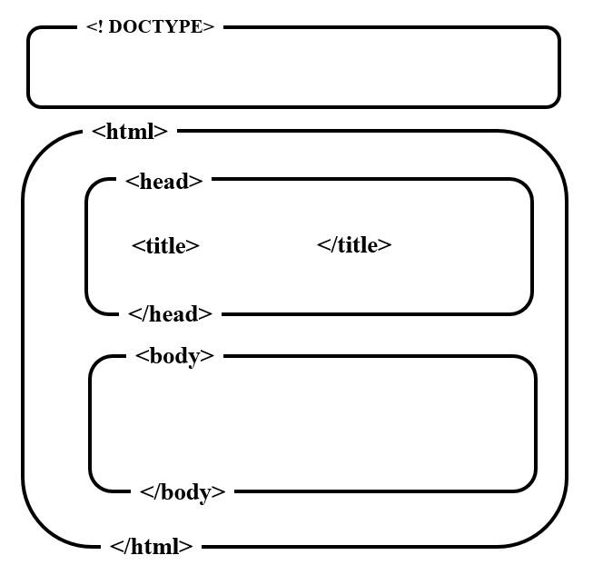
Defines the type of the
document
Root element of HTML page
Contains meta information about
HTML page
title of the HMTL page
Container for all the visible
Content on web page

Slide 23
HTML ELEMENT
An HTML element is defined by a start tag, some content, and an end tag:
<tag name>Content goes here...</tag name>

Slide 24
HTML Attributes
All HTML elements can have attributes
Attributes provide additional information about elements
Attributes are always specified in the start tag
Attributes usually come in name/value pairs like: name="value"

Slide 25
<tag name attribute name = value>
Content goes here...
</tag name>

Slide 26
Designing your
First HTML Page (Web Page)

Slide 27
<!DOCTYPE html>
<html>
<head>
<title>Dontha</title>
</head>
<body>
My first web page - MadhuSudhan, Department of CSE
</body>
</html>

Slide 28
HTML Headings
HTML headings are defined with the <h1> to <h6> tags.
<h1> defines the most important heading. <h6> defines the least important heading.
<h1>Heading 1</h1>
<h2>Heading 2</h2>
<h3>Heading 3</h3>
<h4>Heading 4</h4>
<h5>Heading 5</h5>
<h6>Heading 6</h6>

Slide 29
HTML Paragraphs
The HTML <p> element defines a paragraph.
A paragraph always starts on a new line.
<p>
This paragraph
contains a lot of lines
in the source code,
but the browser
ignores it.
</p>

Slide 30
HTML Horizontal Rules
The <hr> element is used to separate content in HTML page

Slide 31
<html>
<body>
<h1>This is heading 1</h1>
<p>This is some text.</p>
<hr>
<h2>This is heading 2</h2>
<p>This is some other text.</p>
<hr>
</body>
</html>

Slide 32
HTML Line Breaks
The HTML <br> element defines a line break.
<html>
<body>
<p> This is<br>a paragraph<br>with line breaks. </p>
</body>
</html>

Slide 33
HTML Comments
HTML comments are not displayed in the browser, but they can help to organize your code.
Syntax:
<!-- Write your comments here -->
<!-- This below code creates a hyperlink-->

Slide 34
HTML Text Formatting Elements
<b> - Bold text
<strong> - Bold (Important) text
<i> - Italic text
<mark> - marked text (colored)
<u> - underlined text
<del> - deleted text(strike a line through text)
<sub> - Subscript text
<sup> - Superscript text

Slide 35
<html>
<body>
<p>This text is normal.</p>
<p><b>This text is bold.</b></p>
<p><strong>This text is strong.</strong></p>
<p><i>This text is italic.</i></p>
<p>This text is <mark>marked</mark></p>
<p><u>This text is underlined.</u></p>
<p><del>This text is deleted</del></p>
<p>This text is <sub>subscripted</sub></p>
<p>This text is <sup>superscripted</sup></p>
</body>
</html>

Slide 36
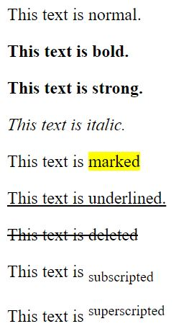

Slide 37
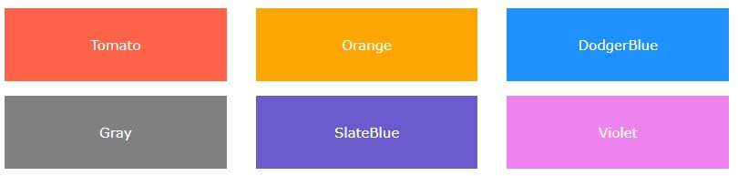
HTML Colors
HTML colors are specified with predefined color names, or with RGB, and HEX values
In HTML, a color can be specified by using a color name:
HTML supports
140 standard
color names

Slide 38
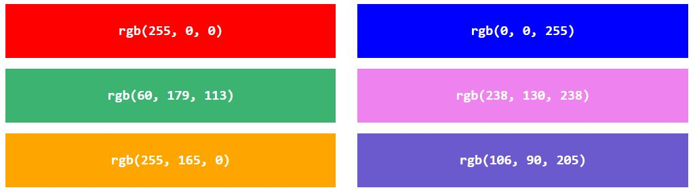
In HTML, a color can be specified as an RGB value, using this formula:
rgb(red, green, blue)
(red, green, and blue) defines the intensity of the color with a value between 0 and 255

Slide 39
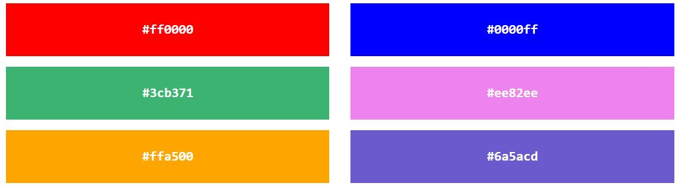
In HTML, a color can be specified using a hexadecimal value in the form:
#rrggbb
Where rr (red), gg (green) and bb (blue) are hexadecimal values between 00 and ff (same as decimal 0-255)

Slide 40
HTML Attributes
All HTML elements can have attributes
Attributes provide additional information about elements
Attributes are always specified in the start tag
Attributes usually come in name/value pairs like: name="value"

Slide 41
<tag name attribute name(property) = value>
Content goes here...
</tag name>

Slide 42
HTML Styles
The HTML style attribute is used to add styles to an element, such as color, font, size, and more.
<tag name style = "property:value;"> content </tag name>

Slide 43
Setting Background Color for Web Page
<html>
<body style= "background-color:green;">
<h1>Setting a background color for my web page</h1>
</body>
</html>

Slide 44
Setting Background Color for a text
<html>
<body>
<h1 style="background-color:blue;">Madhu </h1>
<p style="background-color:yellow;">Dept of CSE</p>
</body>
</html>

Slide 45
Setting Color for a text
<html>
<body>
<h1 style="color:orange;">User Interface Design</h1>
<p style="color:red;">Amrita</p>
</body>
</html>

Slide 46
Setting font and size for a text
<html>
<body>
<h1 style="font-family:verdana;">Amrita</h1>
<p style="font-family:courier;">Amaravathi</p>
<h1 style="font-size:900%;">Madhu</h1>
</body>
</html>

Slide 47
Setting Alignment for a text
<html>
<body>
<h1 style="text-align:center;">Centered Heading</h1>
<p style="text-align:right;">Left paragraph.</p>
</body>
</html>

Slide 48
Combination of all Properties
<html>
<body style="background-color:green;">
<h1 style="color:orange; font-family:verdana; font-size:300%; text-align:center; background-color:white;">
Web Technology
</h1>
</body>
</html>

Slide 49
HTML Images
The HTML <img> tag is used to embed an image in a web page.
Images are not technically inserted into a web page; images are linked to web pages.
The <img> tag creates a holding space for the referenced image.

Slide 50
Syntax:
<img src="url" alt="alternate text">
src attribute specifies the path (URL) to the image.
alt attribute provides an alternate text for an image

Slide 51
Image Size - Width and Height
style="width:500px;height:600px;"
width="500" height="600"

Slide 52
<html>
<body>
<img src="imagename.jpg" alt="Flowers" width="460" height="345">
<img src="imagename.jpg" alt=“cars" style="width:500px;height:600px;">
</body>
</html>

Slide 53
HTML Links - Hyperlinks
HTML links are hyperlinks.
You can click on a link and jump to another document.
When you move the mouse over a link, the mouse arrow will turn into a little hand.

Slide 54
The HTML <a> tag defines a hyperlink. It has the following syntax:
<a href="url">link text</a>
href attribute indicates the link's destination

Slide 55
<html>
<body>
<h1>HTML Links</h1>
<p><a href="https://www.google.com">Google</a></p>
</body>
</html>

Slide 56
HTML Tables
HTML tables allow web developers to arrange data into rows and columns.
Each table row is defined with a <tr> tag. Each table header is defined with a <th> tag. Each table data/cell is defined with a <td> tag.

Slide 57
By default, the text in <th> elements are bold and centered.
By default, the text in <td> elements are regular and left-aligned.

Slide 58
<table width="420" border=“1”>
<tr>
<th>Name</th>
<th>Branch</th>
<th>Cell Number</th>
</tr>
<tr>
<td>Siva</td>
<td>IT</td>
<td>9989878787</td>
</tr>
</table>

Slide 59
Cellpadding & cellspacing
The HTML <table> cellpadding Attribute is used to specify the space between the cell content and cell wall.
The HTML <table> cellspacing Attribute is used to specify the space between the cells.
<table border="1" cellpadding="25" cellspacing="10">

Slide 60
colspan & rowspan
The rowspan attribute specifies the number of rows a cell should span.
The colspan attribute defines the number of columns a cell should span.
<td colspan="2">IT</td>
<td rowspan="2">ECE</td>

Slide 61
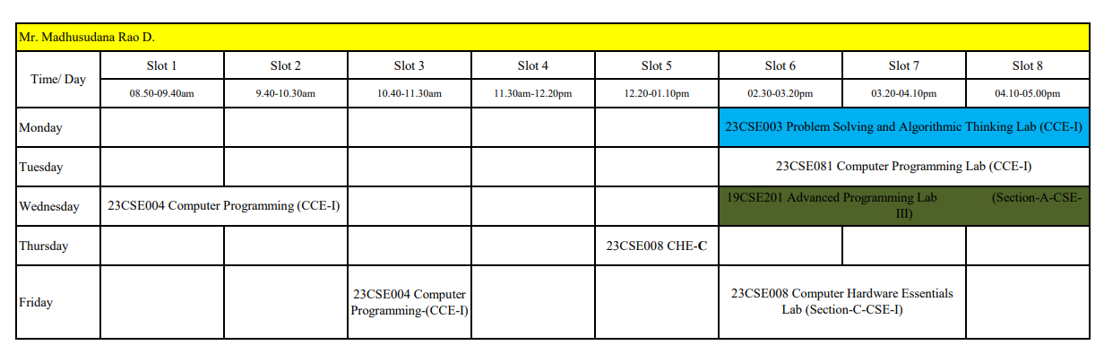

Slide 62
HTML Lists
HTML lists allow web developers to group a set of related items in lists.
Unordered List
Ordered List
Definition
Nested-list

Slide 63
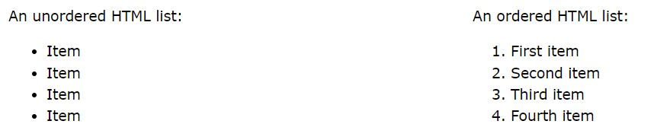

Slide 64
Unordered HTML List
An unordered list starts with the <ul> tag. Each list item starts with the <li> tag.
The list items will be marked with bullets (small black circles) by default

Slide 65
<html>
<body>
<h2>An unordered HTML list</h2>
<ul>
<li>Coffee</li>
<li>Tea</li>
<li>Milk</li>
</ul>
</body>
</html>

Slide 66
Ordered HTML List
An ordered list starts with the <ol> tag. Each list item starts with the <li> tag.
The list items will be marked with numbers by default

Slide 67
<html>
<body>
<h2>An ordered HTML list</h2>
<ol>
<li>Coffee</li>
<li>Tea</li>
<li>Milk</li>
</ol>
</body>
</html>

Slide 68
HTML | Form
An HTML form is used to collect user input
<body>
<form action="https://www.w3docs.com/" method="get" target="_blank">
<button type="submit">Click me</button>
</form>

Slide 69
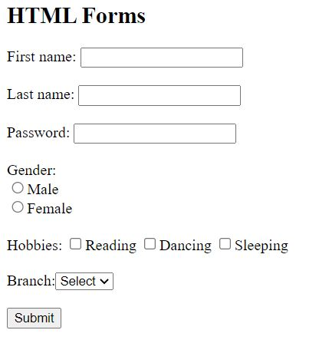

Slide 70
<html>
<body>
<h2>HTML Forms</h2>
<form action=“ destination file">
First name:
<input type="text" name="fname"><br><br>
Last name:
<input type="text" name="lname"><br>
<br>
Password:
<input type="password" name="pass"><br>
<br>

Slide 71
Gender:<br>
<input type="radio" name=“gender">Male<br>
<input type="radio" name=“gender">Female<br>
<br>
Hobbies:
<input type="checkbox" name="read">Reading
<input type="checkbox" name="dance">Dancing
<input type="checkbox" name="sleep">Sleeping<br><br>

Slide 72
Branch:<select name="branch">
<option value="">Select</option>
<option value="IT">IT</option>
<option value="CSE">CSE</option>
<option value="MCA">MCA</option>
</select>
<br><br>
<input type=“button" value="Submit">
</form>
</body>
</html>

Slide 73
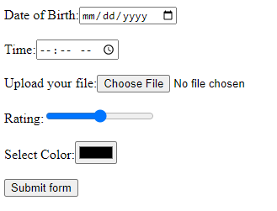

Slide 74
Date of Birth:<input type="date" name="dob"><br><br>
Time:<input type="time" name="time"><br><br>
Upload your file:<input type="file" name="filename"><br><br>
Rating:<input type="range" name="rangevalue"><br><br>
Select Color:<input type="color" name="color"><br><br>
<input type="submit" value="Submit form">

Slide 75

Number:<input type=“number” name=“no”>

Slide 76
HTML Input Attributes for forms
The readonly Attribute
The input readonly attribute specifies that an input field is read-only.
<input type="text" name="fname" readonly>

Slide 77
The disabled Attribute
The input disabled attribute specifies that an input field should be disabled.
A disabled input field is unusable and un-clickable.
<input type="text" name="fname" disabled>

Slide 78
The size Attribute
The input size attribute specifies the visible width, in characters, of an input field.
The default value for size is 20.
<input type="text" name="fname" size=50>

Slide 79
The min and max Attributes
The input min and max attributes specify the minimum and maximum values for an input field.
<input type="date" name="datemax" min="2020-01-01" max="2023-12-31">
<input type="number" name="quantity" min=“1” max=“5”>

Slide 80
The required Attribute
The input required attribute specifies that an input field must be filled out before submitting the form.
<input type="text" name="fname" required>

Slide 81
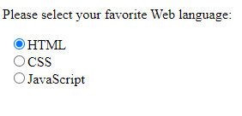
<p>Please select your favorite Web language:</p>
<input type="radio" name="lan" value="HTML">HTML<br>
<input type="radio" name="lan" value="CSS">CSS<br>
<input type="radio" name="lan" value="Java">Java

Slide 82
Background color for text box
<input type="text" style="background-color:red;" name=“fname">

Slide 83
Background image for web page
<body style="background-image: url(‘Amrita.jpg');”>
background-repeat: no-repeat;
background-size: 300px 100px;

Slide 84
Marquee
<marquee direction="right" scrollamount="10" width="60%" height="100px">
Amrita Vishwa Vidyapeetham
</marquee>

Slide 85
HTML Div Element
The <div> element is used as a container for other HTML elements.
The <div> element is often used to group sections of a web page together.
The <div> element is by default a block element, meaning that it takes all available width, and comes with line breaks before and after.

Slide 86
HTML Div Element
<div style width:300px;margin:auto;>
<h2>Andhra Pradesh</h2>
<p>Amaravati</p>
<p>Amrita Vishwa Vidyapeetham.</p>
</div>

Slide 87
Aligning <div> elements side by side/Multiple Div Elements
The float property is used for positioning and formatting content and allows elements to float next to each other instead of on top of each other.
<div style="background-color:#FFF4A3;float:right";
overflow:auto;display:inline-block;>
<h2>Andhra Pradesh</h2>
<p>Amaravati</p>
<p>Amrita Vishwa Vidyapeetham.</p>
</div>

Slide 88
Grid
The CSS Grid Layout Module offers a grid-based layout system, with rows and columns, making it easier to design web pages without having to use floats and positioning.
<style>
.grid-container {
display: grid;
grid-template-columns: 33% 33% 33%;
}
</style>
<div class="grid-container">

Slide 89
<iframe>
The <iframe> tag specifies an inline frame.
An inline frame is used to embed another document within the current HTML document.

Slide 90
Syntax:
<iframe src= “demo.html ” name=“iframe_a” height= “ 200” width= “ 200”> </iframe>

Slide 91
Cascading Style Sheets - CSS

Slide 92
Cascading Style Sheets (CSS) is used to format the layout of a webpage (presentation).
CSS saves a lot of work. It can control the layout of multiple web pages all at once.

Slide 93
Three types of CSS
Inline CSS
Internal CSS
External CSS

Slide 94
Inline CSS
An inline CSS is used to apply a unique style to a single HTML element.
An inline CSS uses the style attribute of an HTML element.

Slide 95
< p style="color:orange;
font-family:verdana;
font-size:300%;
text-align:center;
background-color:white;">welcome</p>

Slide 96
Internal CSS
An internal CSS is used to define a style for a single HTML page.
An internal CSS is defined in the <head> section of an HTML page, within a <style> element.
<head>
<style>
</style>
</head>

Slide 97
<html>
<head>
<style>
p
{
color:blue;
font-family:broadway;
font-size:300%;
}
</style>
</head>
<body>
<p>Madhu</p>
<p>Web technologies</p>
<p>Department of CSE</p>
</body>
</html>

Slide 98
External CSS
An external style sheet is used to define the style for many HTML pages.
To use an external style sheet, add a link to it in the <head> section of each HTML page
<link rel="stylesheet" href="mycss.css">
“rel” attribute specifies the relationship between the current document and the linked document/resource.

Slide 99
mycss.css
p
{
color:blue;
font-family:broadway;
font-size:300%;
}

Slide 100
<html>
<head>
<link rel="stylesheet" href="mycss.css">
</head>
<body>
<p>Madhu</p>
<p>Web technologies</p>
<p>Department of CSE</p>
</body>
</html>

Slide 101
CSS Selectors

Slide 102
The CSS element Selector
The element selector selects HTML elements based on the element name.
p
{
text-align: center;
color: red;
}

Slide 103
The CSS id Selector
The id selector uses the id attribute of an HTML element to select a specific element.
The id of an element is unique within a page, so the id selector is used to select one unique element!
To select an element with a specific id, write a hash (#) character, followed by the id of the element.

Slide 104
<html>
<head>
<style>
#para1
{
text-align: center;
color: red;
}
</style>
</head>
<body>
<p id=“para1”>Amrita University</p>
<p>Amaravathi, Andhra Pradesh</p>
</body>
</html>

Slide 105
The CSS class Selector
The class selector selects HTML elements with a specific class attribute.
To select elements with a specific class, write a period (.) character, followed by the class name.

Slide 106
<html>
<head>
<style>
.center
{
text-align: center;
color: red;
}
</style>
</head>
<body>
<h1 class=“center”>Amrita University</h1>
<p class=“center”>Amaravathi, Andhra Pradesh</p>
</body>
</html>

Slide 107
The CSS Universal Selector
The universal selector (*) selects all HTML elements on the page.

Slide 108
<html>
<head>
<style>
*
{
text-align: center;
color: blue;
}
</style>
</head>
<body>
<h1>Amrita University</h1>
<p>Amaravathi</p>
<h2>Andhra Pradesh</h2>
<p>India</p>
</body>
</html>

Slide 109
The CSS Grouping Selector
The grouping selector selects all the grouped HTML elements with the same style definitions.
h1 { text-align: center; color: red; } | h2 { text-align: center; color: red; } | p { text-align: center; color: red; }

Slide 110
<html>
<head>
<style>
h1, h2, p
{
text-align: center;
color: red;
}
</style>
</head>
<body>
<h1>Amrita University</h1>
<h2>Amaravathi</h2>
<p>India</p>
</body>
</html>

Slide 111
CSS Properties

Slide 112
A CSS property assign a style or behavior to an HTML element.
Examples include: color, border, margin, font-style, transform and so on………
There are about 228+ CSS Properties

Slide 113
CSS Text Property
Text Color and Background Color
background-color: black;
color: green;

Slide 114
CSS Text Property
Text Alignment
text-align: center;
text-align: left;
text-align: right;
text-align: justify;

Slide 115
CSS Text Property
Text Decoration
text-decoration: overline;
text-decoration: line-through;
text-decoration: underline;
text-decoration: overline underline;

Slide 116
CSS Text Property
Text Transformation
text-transform: uppercase;
text-transform: lowercase;
text-transform: capitalize;

Slide 117



CSS Text Property
Text Shadow
text-shadow: 2px 2px;
text-shadow: 2px 2px red;
text-shadow: 2px 2px 5px red;

Slide 118
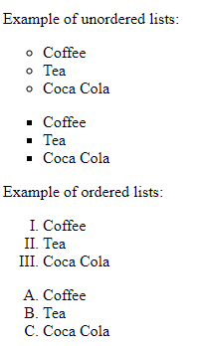
CSS List Property
list-style-type: circle;
list-style-type: square;
list-style-type: upper-roman;
list-style-type: upper-alpha;

Slide 119
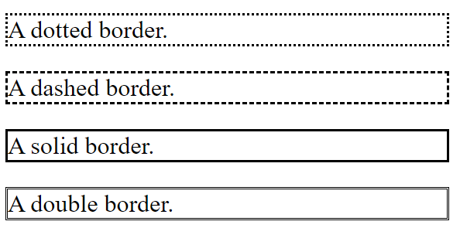
border-color: red;
border-width:10px;
border-style: style name;
CSS Border Property

Slide 120
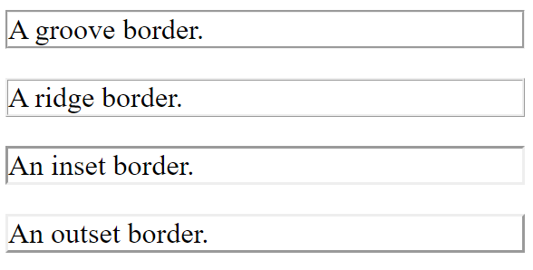

Slide 121
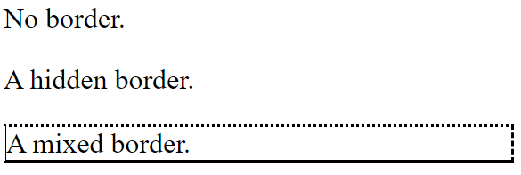
border-style: none;
border-style: hidden;
border-style: dotted dashed solid double;

Slide 122
CSS font Property
font-style | Specifies the font style. (normal, italic, oblique)
font-weight | Specifies the font weight. (normal, bold, light)
font-size | Specifies the font size (small, medium ,large) in px
font-family | Specifies the font family. (various styles available)

Slide 123
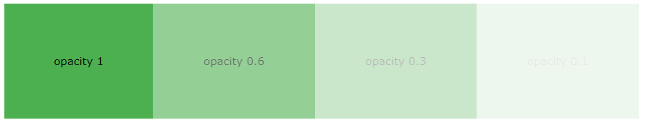
CSS Background Property
Background Color
background-color: green;
opacity: 0.3;

Slide 124
CSS Background Property
Background Image
background-image: url(“Amrita.png");
background-repeat: no-repeat;
background-position: right top;
background-size: 300px 100px; (auto, cover)
background-attachment: fixed; (Optional)

Slide 125
.button {
background-color: #04AA6D; /* Green */
border: none;
color: white;
padding: 15px 32px;
text-align: center;
text-decoration: none;
display: inline-block;
font-size: 16px;
margin: 4px 2px;
cursor: pointer;
}
Try it Yours

Slide 126
<!DOCTYPE html>
<html>
<head>
<style>
<link rel=“style sheets” href=“button.css”>
</style>
</head>

Slide 127
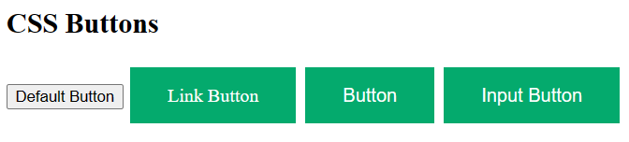
<body>
<h2>CSS Buttons</h2>
<button>Default Button</button>
<a href="#" class="button">Link Button</a>
<button class="button">Button</button>
<input type="button" class="button" value="Input Button">
</body>
</html>

Slide 128
SVG
SVG stands for Scalable Vector Graphics.
SVG defines vector-based graphics in XML format.
SVG graphics are scalable and do not lose quality if zoomed or resized.

Slide 129
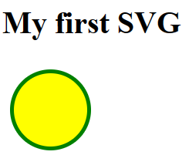
<html>
<body>
<h1>My first SVG</h1>
<svg width="100" height="100" xmlns="http://www.w3.org/2000/svg">
<circle cx="50" cy="50" r="40" stroke="green" stroke-width="4" fill="yellow" />
</svg>
</body>
</html>

Slide 130
SVG Shapes
SVG has some predefined shape elements that developers can use:
Rectangle <rect>
Circle <circle>
Ellipse <ellipse>
Line <line>
Polyline <polyline>
Polygon <polygon>
Path <path>

Slide 131
HTML Multimedia
Multimedia comes in many different formats. It can be almost anything we can hear or see, like images, music, sound, videos, records, films, animations, and more.

Slide 132
HTML Video
The HTML <video> element is used to show a video on a web page.
<html>
<body>
<video width="320" height="240" controls>
<source src="movie.mp4" type="video/mp4">
<source src="movie.ogg" type="video/ogg">
</video>
</body>
</html>

Slide 133
HTML Audio
The HTML <audio> element is used to play an audio file on a web page
<html>
<body>
<audio controls>
<source src="horse.ogg" type="audio/ogg">
<source src="horse.mp3" type="audio/mpeg">
</audio>
</body>
</html>

Slide 134
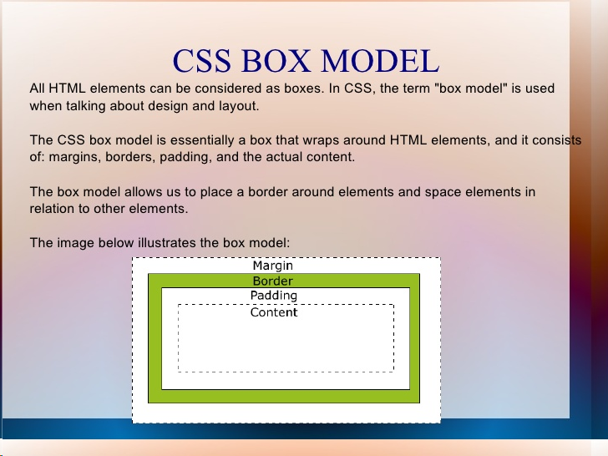

Slide 135
CSS Padding
The CSS padding properties generate space around an element's content inside any defined borders.
There are properties for setting the padding for each side of an element (top, right, bottom, and left)

Slide 136
The padding property is a shorthand property for the
following individual padding properties:
padding-top
padding-right
padding-bottom
padding-left
padding: 25px 50px 75px 100px;

Slide 137
CSS Margins
The CSS margin properties are used to create space around elements outside of any defined borders.
There are properties for setting the margin for each side of an element (top, right, bottom, and left)

Slide 138
div {
border: 1px solid black;
margin-top: 100px;
margin-bottom: 100px;
margin-right: 150px;
margin-left: 80px;
background-color: light blue;
}
All the margin properties can have the following values:
auto - the browser calculates the margin
length - specifies a margin in px, pt, cm, etc.
% - specifies a margin in % of the width of the containing element
inherit - specifies that the margin should be inherited from the parent element

Slide 139
Calculating overall dimensions:
When designing our page, we have to calculate how much size a <div> element will consume:
  Total element width = defined width + left padding + right padding + left border + right border + left margin + right margin.
  Total element height = defined height + top padding + bottom padding + top border + bottom border + top margin + bottom margin

Slide 140
CSS position Property
The position property specifies the type of positioning method used for an element (static, relative, fixed, absolute, or sticky).
An element with position: static; is not positioned in any unique way; it is always positioned according to the normal flow of the page:
<style>
div.static {
position: static;
border: 3px solid #73AD21;
}
</style>

Slide 141
An element with position: relative; is positioned relative to its normal position.
Setting a relatively positioned element's top, right, bottom, and left properties will cause it to be adjusted away from its normal position.
<style>
div.relative {
position: relative;
left: 30px;
border: 3px solid #73AD21;
}
</style>

Slide 142
An element with position: fixed; is positioned relative to the viewport, which means it always stays in the same place even if the page is scrolled. The top, right, bottom, and left properties position the element.
A fixed element does not leave a gap in the page where it would normally have been located.
<style>
div.fixed {
position: fixed;
bottom: 0;
right: 0;
width: 300px;
border: 3px solid blue;
}
</style>

Slide 143
An element with position: absolute is positioned relative to the nearest positioned ancestor (instead of positioned relative to the viewport, like fixed).
However; if an absolute positioned element has no positioned ancestors, it uses the document body, and moves along with page scrolling.

Slide 144
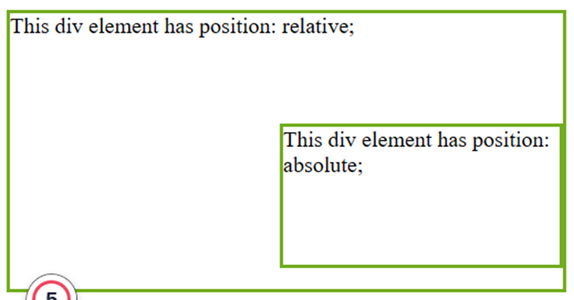
<style>
div.relative {
position: relative;
width: 400px;
height: 200px;
border: 3px solid #73AD21;
}
div.absolute {
position: absolute;
top: 80px;
right: 0;
width: 200px;
height: 100px;
border: 3px solid #73AD21;
}

Slide 145
An element with position: sticky; is positioned based on the user's scroll position.
A sticky element toggles between relative and fixed,depending on the scroll position. It is positioned relative until a given offset position is met in the viewport - then it "sticks" in place (like position:fixed).
<style>
div.sticky {
position: sticky;
top: 0;
padding: 5px;
background-color: #cae8ca;
border: 2px solid #4CAF50;
}
</style>

Slide 146
CSS Transitions
CSS transitions allow the change of property values smoothly over a given duration.
Mouse over the element below to see a CSS transition effect:
transition
transition-delay
transition-duration
transition-property
transition-timing-function

Slide 147
CSS Transition Properties
Property | Description
transition | A shorthand property for setting the four transition properties into a single property
transition-delay | Specifies a delay (in seconds) for the transition effect
transition-duration | Specifies how many seconds or milliseconds a transition effect takes to complete
transition-property | Specifies the name of the CSS property the transition effect is for
transition-timing-function | Specifies the speed curve of the transition effect

Slide 148
How to Use CSS Transitions?
To create a transition effect, we must specify two things:
The CSS property you want to add an effect to
The duration of the effect
div {
width: 100px;
height: 100px;
background: red;
transition: width 2s;
}
div: hover {
width: 300px;
}

Slide 149
<!DOCTYPE html>
<html>
<head>
<style>
div {
width: 100px;
height: 100px;
background: red;
transition: width 2s, height 4s;
}
div:hover {
width: 300px;
height: 300px;
}
</style>
</head>

Slide 150
<body>
<h1>The transition Property</h1>
<p>Hover over the div element below, to see the
transition effect:</p>
<div></div>
</body>
</html>

Slide 151
Delay the Transition Effect
The transition-delay property specifies a delay (in seconds) for the transition effect.
The following example has a 1-second delay before starting:
div {
width: 100px;
height: 100px;
background: red;
transition: width 3s;
transition-delay: 1s;
}
div: hover {
width: 300px;
}

Slide 152
Delay the Transition Effect
The transition-delay property specifies a delay (in seconds) for the transition effect.
The following example has a 1-second delay before starting:
div {
width: 100px;
height: 100px;
background: red;
transition: width 3s;
transition-delay: 1s;
}
div: hover {
width: 300px;
}

Slide 153
The transition-timing function property specifies the speed curve of the transition effect.
The transition-timing-function property can have the following values:
Ease - specifies a transition effect with a slow start, then fast, and end slowly (this is the default)
linear - specifies a transition effect with the same speed from start to end
ease-in - specifies a transition effect with a slow start
ease-out - specifies a transition effect with a slow end
ease-in-out - specifies a transition effect with a slow start and end

Slide 154
The transition-timing function
<style>
div {
width: 100px;
height: 100px;
background: red;
transition: width 2s;
}
#div1 {transition-timing-function: linear;}
#div2 {transition-timing-function: ease;}
#div3 {transition-timing-function: ease-in;}
#div4 {transition-timing-function: ease-out;}
#div5 {transition-timing-function: ease-in-out;}
div:hover {
width: 300px;
}

Slide 155
<!DOCTYPE html>
<html>
<head>
<style>
div {
width: 100px;
height: 100px;
background: red;
transition-property: width;
transition-duration: 2s;
transition-timing-function: linear;
transition-delay: 1s;
}
div:hover {
width: 300px;
}
</style>

Slide 156
</head>
<body>
<h1>The transition Properties Specified One by One</h1>
<p>Hover over the div element below, to see the transition effect:</p>
<div></div>
<p><b>Note:</b> The transition effect has a 1-second delay before starting.</p>
</body>
</html>

Slide 157
CSS Animations
CSS allows the animation of HTML elements without using JavaScript
An animation lets an element gradually change from one style to another.
To use CSS animation, we must first specify some keyframes.
Keyframes hold what styles the element will have at certain times.

Slide 158
CSS Animations Properties
Property | Description
@keyframes | Specifies the animation code
animation | A shorthand property for setting all the animation properties
animation-delay | Specifies a delay for the start of an animation
animation-direction | Specifies whether an animation should be played forwards, backwards or in alternate cycles
animation-duration | Specifies how long time an animation should take to complete one cycle
animation-fill-mode | Specifies a style for the element when the animation is not playing (before it starts, after it ends, or both)
animation-iteration-count | Specifies the number of times an animation should be played
animation-name | Specifies the name of the @keyframes animation
animation-play-state | Specifies whether the animation is running or paused
animation-timing-function | Specifies the speed curve of the animation

Slide 159
The @keyframes Rule
When we specify CSS styles inside the @keyframes rule, the animation will gradually change from the current style to the new style at certain times.
To get an animation to work, we must bind the animation to an element.

Slide 160
<html>
<head>
<style>
div {
width: 100px;
height: 100px;
background-color: red;
animation-name: example;
animation-duration: 4s;
}
@keyframes example {
from {background-color: red;}
to {background-color: yellow;}
}
</style>
</head>
example binds the "example" animation to the <div> element. The animation will last for 4 seconds, and it will gradually change the background color of the <div> element from "red" to "yellow"

Slide 161
The animation-duration property defines how long an animation should take to complete. If the animation-duration property is not specified, no animation will occur, because the default value is 0s (0 seconds).
<style>
div {
width: 100px;
height: 100px;
background-color: red;
animation-name: example;
animation-duration: 4s;
}
@keyframes example {
0% {background-color: red;}
25% {background-color: yellow;}
50% {background-color: blue;}
100% {background-color: green;}
}
</style>
example will change the background color of the <div> element when the animation is 25% complete, 50% complete, and again when the animation is 100% complete

Slide 162
example will change both the background color and the position of the <div> element when the animation is 25% complete, 50% complete, and again when the animation is 100% complete
@keyframes example {
0% {background-color:red; left:0px; top:0px;}
25% {background-color:yellow; left:200px; top:0px;}
50% {background-color:blue; left:200px; top:200px;}
75% {background-color:green; left:0px; top:200px;}
100% {background-color:red; left:0px; top:0px;}
}
div {
width: 100px;
height: 100px;
position: relative;
background-color: red;
animation-name: example;
animation-duration: 4s;
}

Slide 163
The animation-iteration-count property specifies the number of times an animation should run.
<style>
div {
width: 100px;
height: 100px;
background-color: red;
position: relative;
animation-name: example;
animation-duration: 4s;
animation-iteration-count: 3;
}
@keyframes example {
0% {background-color:red; left:0px; top:0px;}
25% {background-color:yellow; left:200px; top:0px;}
50% {background-color:blue; left:200px; top:200px;}
75% {background-color:green; left:0px; top:200px;}
100% {background-color:red; left:0px; top:0px;}
}
</style>
example will run the animation 3 times before it stops

Slide 164
The animation-direction property specifies whether an animation should be played forwards, backwards or in alternate cycles.
The animation-direction property can have the following values:
normal - The animation is played as normal (forwards).This is default
reverse - The animation is played in reverse direction (backwards)
alternate - The animation is played forwards first, then backwards
alternate-reverse - The animation is played backwards first, then forwards

Slide 165
<style>
div {
width: 100px;
height: 100px;
background-color: red;
position: relative;
animation-name: example;
animation-duration: 4s;
animation-iteration-count: 2;
animation-direction: alternate-reverse;
}
@keyframes example {
0% {background-color:red; left:0px; top:0px;}
25% {background-color:yellow; left:200px; top:0px;}
50% {background-color:blue; left:200px; top:200px;}
75% {background-color:green; left:0px; top:200px;}
100% {background-color:red; left:0px; top:0px;}
}
</style>
div {
width: 100px;
height: 100px;
position: relative;
background-color: red;
animation-name: example;
animation-duration: 4s;
animation-iteration-count: 2;
animation-direction: alternate;
}
div {
width: 100px;
height: 100px;
position: relative;
background-color: red;
animation-name: example;
animation-duration: 4s;
animation-direction: reverse;
}

Slide 166
The animation-delay property specifies a delay for the start of an animation.
<style>
div {
width: 100px;
height: 100px;
background-color: red;
position: relative;
animation-name: example;
animation-duration: 4s;
animation-delay: 2s;
}
@keyframes example {
0% {background-color:red; left:0px; top:0px;}
25% {background-color:yellow; left:200px; top:0px;}
50% {background-color:blue; left:200px; top:200px;}
75% {background-color:green; left:0px; top:200px;}
100% {background-color:red; left:0px; top:0px;}
}
</style>
The following example has a 2 seconds delay before starting the animation:

Slide 167
The animation-timing-function property specifies the speed curve of the animation.
ease - Specifies an animation with a slow start, then fast, then end slowly (this is default)
linear - Specifies an animation with the same speed from start to end
ease-in - Specifies an animation with a slow start
ease-out - Specifies an animation with a slow end
ease-in-out - Specifies an animation with a slow start and end
cubic-bezier(n,n,n,n) - Lets you define your own values in a cubic-bezier function

Slide 168
The animation-fill-mode property specifies a style for the target element when the animation is not playing (before it starts, after it ends, or both).
none - Default value. Animation will not apply any styles to the element before or after it is executing
forwards - The element will retain the style values that is set by the last keyframe (depends on animation-direction and animation-iteration-count)
backwards - The element will get the style values that is set by the first keyframe (depends on animation-direction), and retain this during the animation-delay period
both - The animation will follow the rules for both forwards and backwards, extending the animation properties in both directions

Slide 169
<style>
div {
width: 100px;
height: 100px;
background: red;
position: relative;
animation-name: example;
animation-duration: 3s;
animation-fill-mode: forwards;
}
@keyframes example {
from {top: 0px;}
to {top: 200px; background-color: blue;}
}
</style>
div {
width: 100px;
height: 100px;
background: red;
position: relative;
animation-name: example;
animation-duration: 3s;
animation-delay: 2s;
animation-fill-mode: both;
}
div {
width: 100px;
height: 100px;
background: red;
position: relative;
animation-name: example;
animation-duration: 3s;
animation-delay: 2s;
animation-fill-mode: backwards;
}

Slide 170
CSS transform Property
The transform property in CSS is used to change the coordinate space of the visual formatting model. This adds effects like skew, rotate, translate, etc on elements.
.element {
width: 20px;
height: 20px;
transform: scale(20); }
Even with a declared height and width, this element will now be scaled to twenty times its original size

Slide 171
Different values of the transform property
none: No transformation takes place.
matrix(x, x, x, x, x, x): It specifies a matrix transformation of 2-D type. It takes 6 values.
matrix3d(x, x, x, x, x, x, x, x, x): It specifies a matrix transformation of 3-D type. It takes 9 values.
translate(x, y): It specifies a translation across the X and Y axes.
translate3d(x, y, z): It specifies a translation across the X, Y, and Z axes.
translateX(x): It specifies the translation across the X-axis only. translateY(y): It specifies the translation across the Y-axis only.
translateZ(z): It specifies the translation across the Z-axis only.
rotate(angle): It specifies the angle of rotation.
rotateX(angle): It specifies the rotation along with the X-axis corresponding to the angle of rotation.

Slide 172
Different values of the transform property
rotateY(angle): It specifies the rotation along with the Y-axis corresponding to the angle of rotation.
rotateZ(angle): It specifies the rotation along with the Z-axis corresponding to the angle of rotation.
scale(x, y): It specifies the scale transformation along the X and Y axes.
scaleX(x): It specifies the scale transformation along the X-axis.
scaleY(y): It specifies the scale transformation along the Y-axis.
scaleZ(z): It specifies the scale transformation along the Z-axis.
scale3d(x, y, z): It specifies the scale transformation along the X, Y, and Z axes.
skew(angle, angle): It specifies the skew transformation along the X and Y axes corresponding to the skew angles.
skewX(angle): It specifies the skew transformation along with the X-axis corresponding to the skew angle.

Slide 173
Different values of the transform property
skewY(angle): It specifies the skew transformation along with the Y-axis corresponding to the skew angle.
skewZ(angle): It specifies the skew transformation along with the Z-axis corresponding to the skew angle.
perspective(x): It specifies the perspective of an element.
initial: It initializes the element to its default value.
inherit: It inherits the value from its parent element
<div>Transformed element</div>
div {
border: solid red;
transform: translate(30px, 20px) rotate(20deg);
width: 140px;
height: 60px;
}

Slide 174
transform: none;
transform: rotate(45deg);
transform: rotateX(45deg);
transform: rotateX(100deg);
transform: rotateY(45deg);
transform: skew(20deg,20deg);
transform: skewX(30deg);
transform: skewX(40deg);
transform: skewY(30deg);
transform: translate(20px,10px);
transform: scale(2,2);
transform: matrix(0.866,0.7,-0.8,0.866,0,0);
transform: matrix(0.586,0.8,-0.8,0.586,0,0);
transform: matrix(0.586,0.8,-0.8,0.586,40,30);

Slide 175
<div class="element one">
rotateX
</div>
<div class="element two">
rotateY
</div>
<div class="element three">
rotateZ
</div>
@keyframes one {
0% {
transform: rotateX(0);
}
100% {
transform: rotateX(50deg);
}
}
@keyframes two {
0% {
transform: rotateY(0);
}
100% {
transform: rotateY(70deg);
}
}
@keyframes three {
0% {
transform: rotateZ(0);
}
100% {
transform: rotateZ(100deg);
}
}
.one {
transform: rotateX(40deg);
animation: one 2s infinite;
animation-direction: alternate;
}
.two {
transform: rotateY(40deg);
animation: two 2s infinite;
animation-direction: alternate;
background-color: #831a4a;
}
.three {
transform: rotateZ(100deg);
animation: three 2s infinite;
animation-direction: alternate;
background-color: #439772;
}
body {
display: flex;
flex-direction: column;
align-items: center;
justify-content: center;
}

